Slide 1


Slide 2
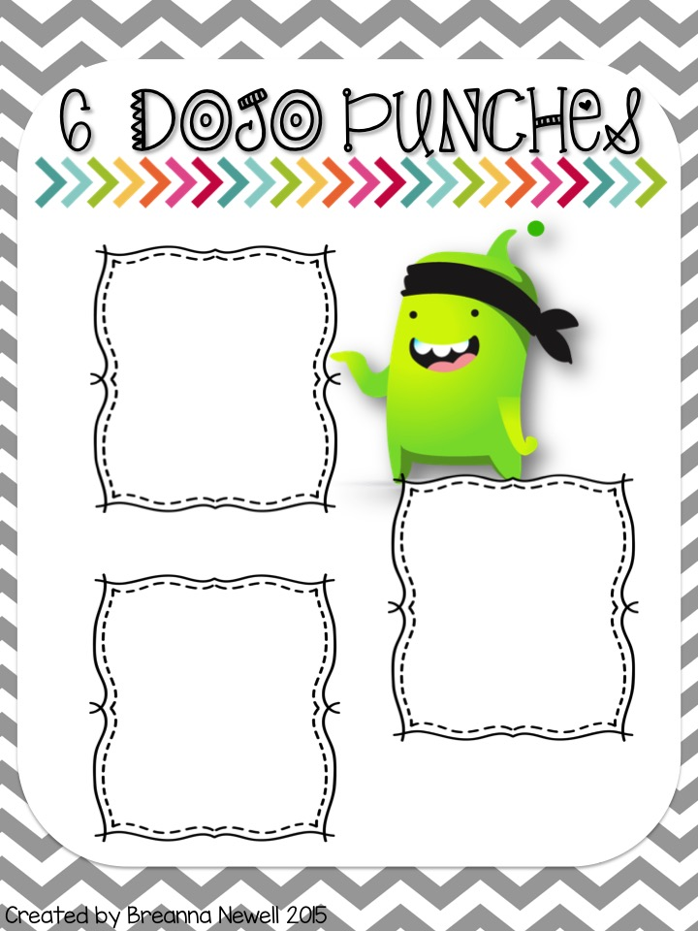
Wear your slippers during our class time.
**You must change into regular shoes during Specials, Lunch, & Recess!
Wear your sunglasses during class
**You must take these off during Specials, Lunch, & Recess!
Write with colorful pens all day!

Slide 3
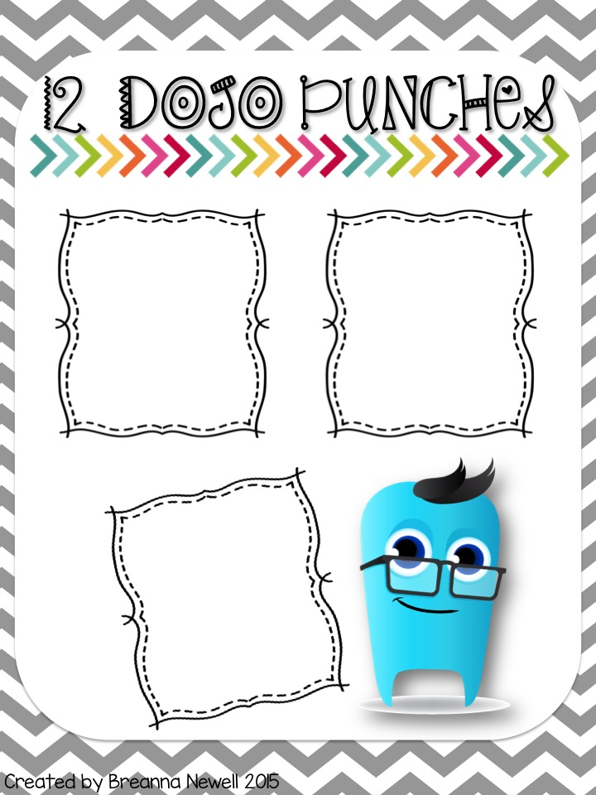
Listen to music while you work for the day.
**You must have headphones and it must be school appropriate! This cannot be used when the teacher is teaching.
Sit at your desk with a pillow or stuffed animal for the day.
**The pillow or stuffed animal must fit in your book bag!
Make your table group the leaders for the day! This means you will be chosen 1st to line up, clean up, etc.

Slide 4
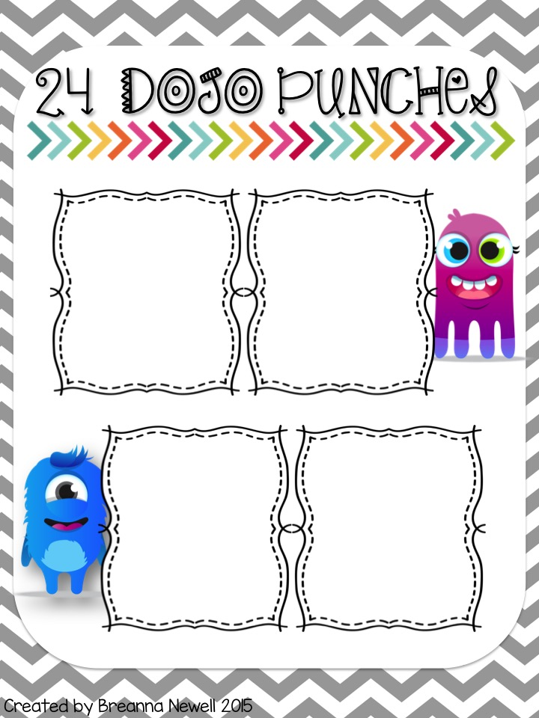
No Homework Pass!
Get out of
One
assignment during the
school day!
**May not be used on a project or a test/quiz.
15 Minutes of iPad time during the day.
**You may not use this when the teacher is teaching.
Wear your favorite hat in class!
**You must leave it at your seat during Related Arts, Lunch, & Recess!

Slide 5
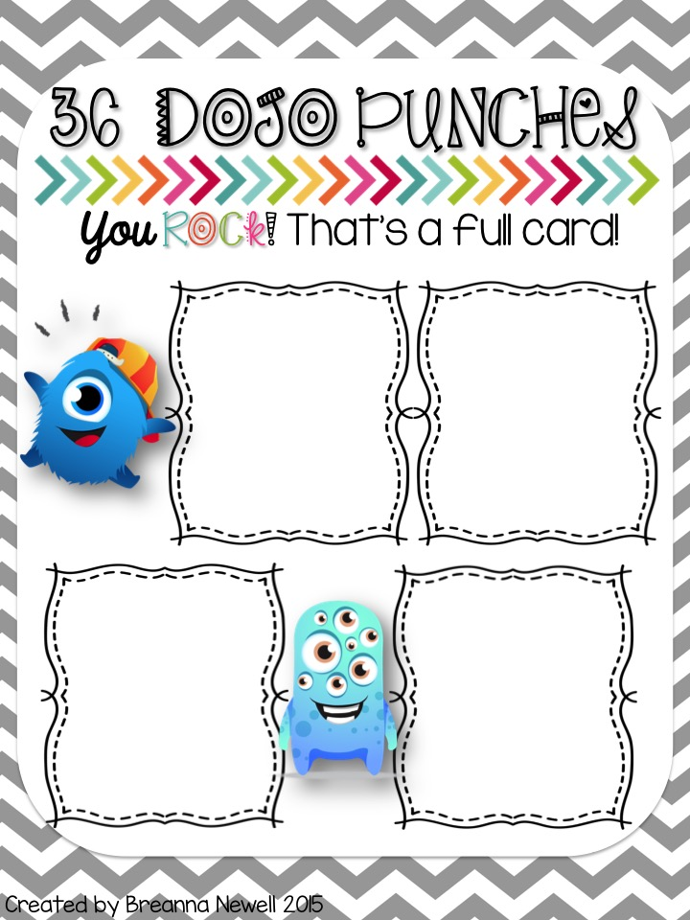
Sit at the teacher’s desk
**You must use your own supplies at the desk!
Switch seats with a friend for the day!
Eat lunch with your amazing
teacher! ☺
Bring in a fun snack to enjoy for yourself or the class!

Slide 6
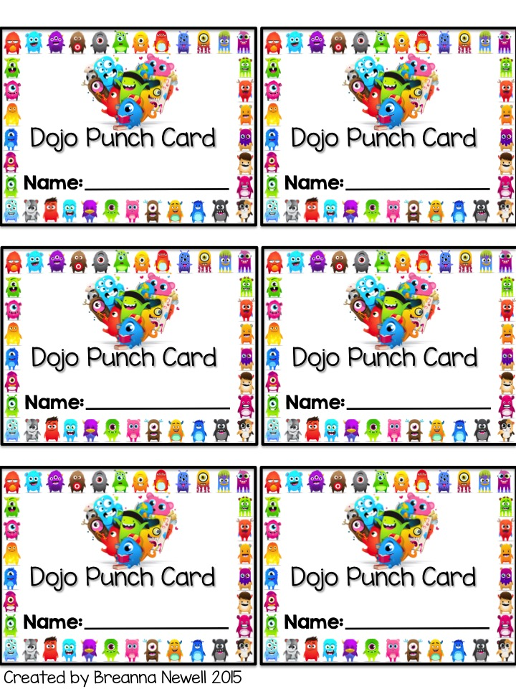
For every five positive Dojo points you earn, you will receive one Dojo punch!
For every five positive Dojo points you earn, you will receive one Dojo punch!
For every five positive Dojo points you earn, you will receive one Dojo punch!
For every five positive Dojo points you earn, you will receive one Dojo punch!
For every five positive Dojo points you earn, you will receive one Dojo punch!
For every five positive Dojo points you earn, you will receive one Dojo punch!

